Slide 1
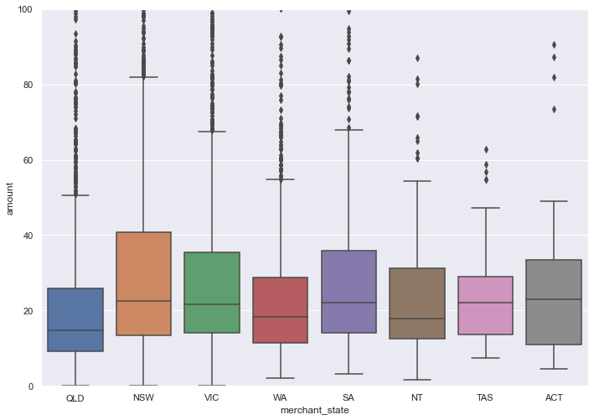
Distribution of amount transacted according to various merchant states
From this diagram, we can conclude that New South Wales(NSW) has the highest maximum amount transacted across the other states. However, by observation, the average amount do not defer significantly across different states, hence we can assume that the consumers/customers of the bank have roughly similar amount patterns across states, albeit a few amounts that are > 75% percentile

Slide 2
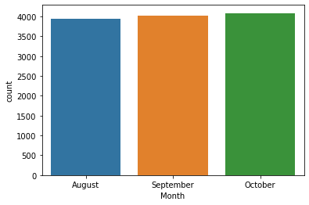
Number of transactions per month
From the count plot, we can observe that the number of transactions has increased from August to September to October. Hence, we can conjecture that possibly people may spend more or possible save more(put money into the bank), which can be found by doing a count plot of the movement section of the data provided. If the consumers spend more, we can adjust our interest rate so that consumers may save instead of consume more.

